Slide 1








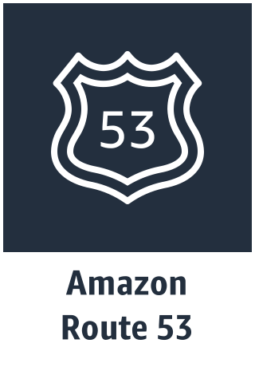

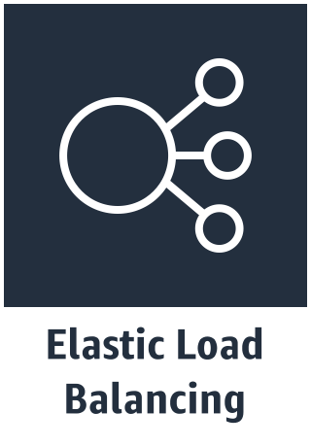
AWS Cloud
Availability Zone 1
Availability Zone 2
VPC
Public subnet
Public subnet
Auto Scaling group
NAT gateway
Bastion host
Bastion host
NAT gateway
10.0.128.0/20
10.0.144.0/20
Private subnet
Private subnet
<your product Instances>
<your product Instances>
10.0.0.0/19
10.0.32.0/19
10.0.0.0/16

